Slide 1

Risk of having stroke among patients treated with catheterization during hospitalization
Practical Experience Working with medical data sets | October 2022
Moriya Yulzari & Linoy Valko

Slide 2


THE TEAM
Moriya
Linoy

Slide 3
Background
Approximately 50,000 catheterizations are performed in Israel, every year.
In the US, more than a million catheterizations performed every year.
As a result of the procedure,
a blood clot can be caused.
A blood clot can cause a stroke.
This is not a common
phenomenon, but can be reduced.

Slide 4
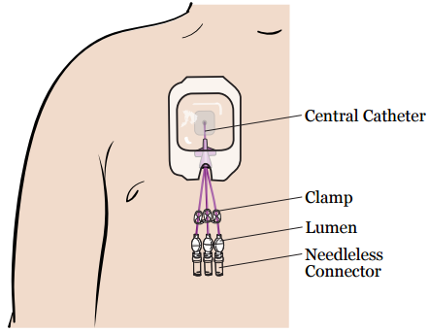
AIM OF PROJECT
To establish a model that predicts the possibility of having a stroke after treated with catheterization, during hospitalization time.

Slide 5
THE PROBLEM
In a perfect world the medical team would have the option to monitor their patients and get a real time alerts, in order to prevent strokes.
Benefits:
Doctors will be able to prioritize treatments.
Less mistakes.
Minimize the number of in-hospital stroke cases.
Saving money and facilities.

Slide 6
THE PROPOSED SOLUTION
We created a classification model that predicts the probability of having in-hospital stroke, after being treated with catheterization.

Slide 7
DATA& VARIABLES
Our dataset was based on ‘Mimic4’ (source dataset).
Outcome variable - ‘has a stroke’(0-no, 1-yes).
Study population - people who were in-hospital treated with catheterization.
14 Relevant features - comorbid condition, age, gender.

Slide 8

DATA& VARIABLES - EDA
The data preparation included:
Data cleansing - delete duplicates by subject id
Missing values - not needed
Outliers - not needed
Encoding - gender (F - 0, M-1)

Slide 9
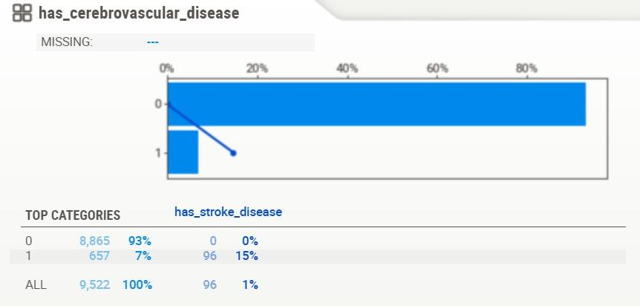
DATA& VARIABLES - EDA

Slide 10
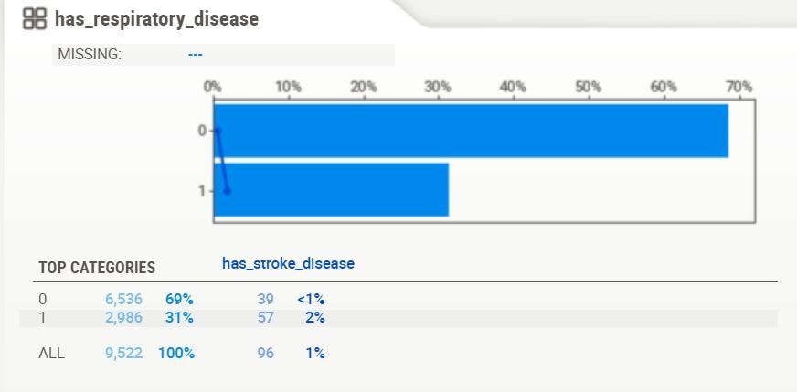
DATA& VARIABLES - EDA

Slide 11
MODEL
Model | Undersampling | N | Hyperparameters
SVM | 1:99 | 7745 | -
SVM | 1:9 | 802 | -
Random Forest | 1:9 | 802 | n_estimators = 2
Logistic Regression | 1:9 | 802 | solver = liblinear
Logistic Regression | 1:3 | 242 | solver = liblinear

Slide 12
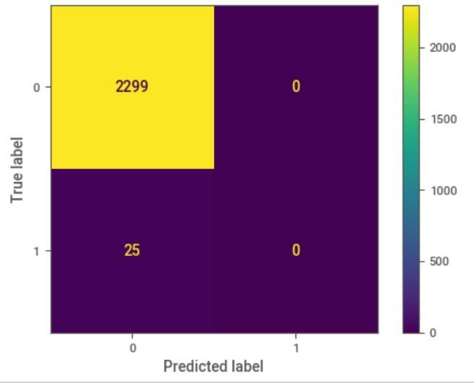
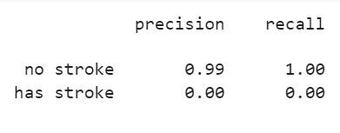
EVALUATION OF THE FIRST SVM
Accuracy - 98.92%
Ratio - 1:99
Failed to classify between 0 to 1

Slide 13
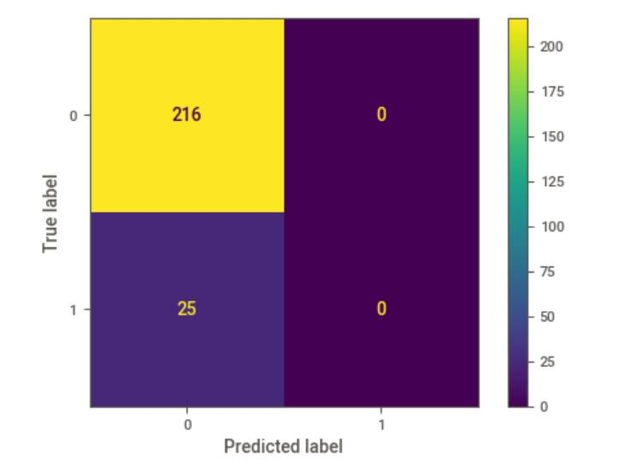
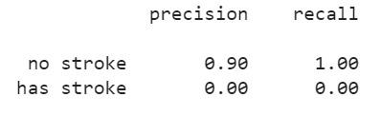
EVALUATION OF THE SECOND SVM
Accuracy - 89.62%
Ratio - 1:9
Failed to classify between 0 to 1

Slide 14
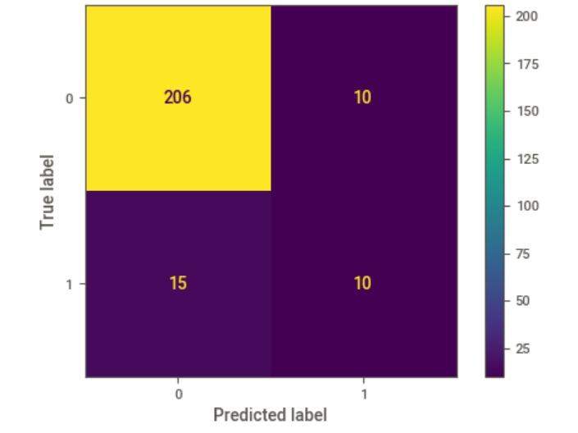
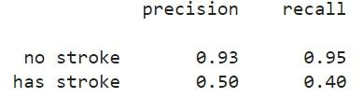
EVALUATION OF Random Forest
Accuracy - 89.63%
Ratio - 1:9
Succeeded to classify between 0 to 1

Slide 15
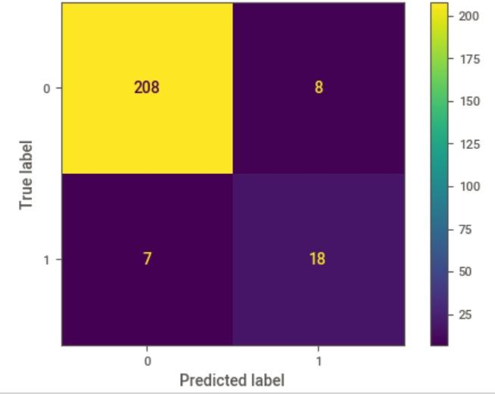
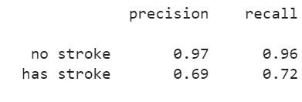
EVALUATION OF FIRST LOGISTIC REGRESSION
Accuracy - 93.77%
Ratio - 1:9
Succeeded to classify between 0 to 1

Slide 16
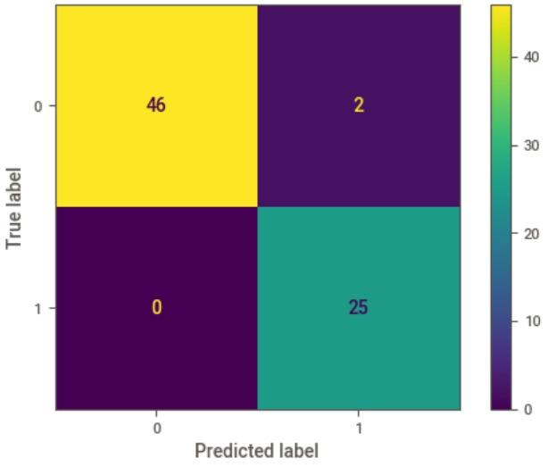
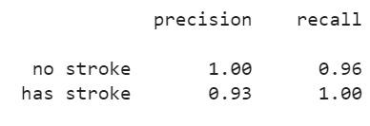
EVALUATION OF SECOND LOGISTIC REGRESSION
Accuracy - 97.26%
Ratio - 1:3
Succeeded to classify between 0 to 1

Slide 17
Results
Model | Undersampling | Accuracy | Recall | Precision
SVM | 1:99 | 98.92% | 0 | 0
SVM | 1:9 | 89.62% | 0 | 0
Random Forest | 1:9 | 89.63% | 50% | 40%
Logistic Regression | 1:9 | 93.97% | 72% | 69%
Logistic Regression | 1:3 | 97.26% | 100% | 93%

Slide 18
CONCLUSIONS
The most important step is to characterization the problem accurately.
The most sophisticated model is not necessarily the best one.
Imbalance in the outcome variable can fail the model.

Slide 19

FURTHER STEPS
To enrich the data features.
To increase the study population.
To increase the target’s values.
To test additional models.

Slide 20
Thank you!

